Slide 1



ADVANCED SYSTEMS PROGRAMING
Systems Programming - C Projects
STUDENT NAME | AINEDEMBE DENIS
REG. NO | 2024-M132-23999
LECTURER | Dr. WAUYO FRED
Github Repository:
https://github.com/Ainedembe-Denis/Systems-Programing---C-PROJECTS

Slide 2
Bank Account Management System
1
A system for managing bank accounts. It supports:
account creation,
deposits,
withdrawals,
balance inquiries and
account details inquiries
Role-based access (Teller/Admin).
Multi-currency support (UGX/USD).
Minimum balance enforcement.
Audit logging.

Slide 3
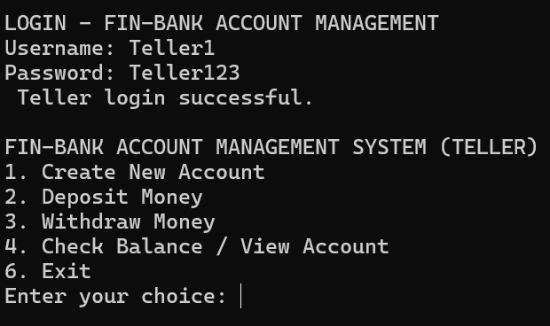
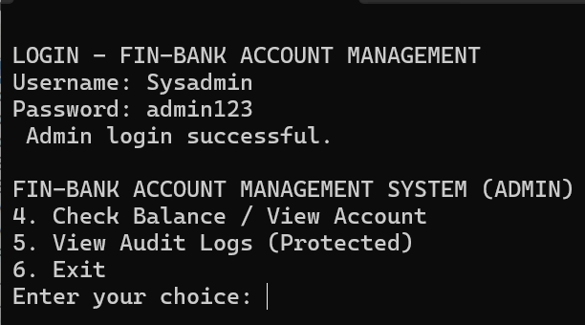
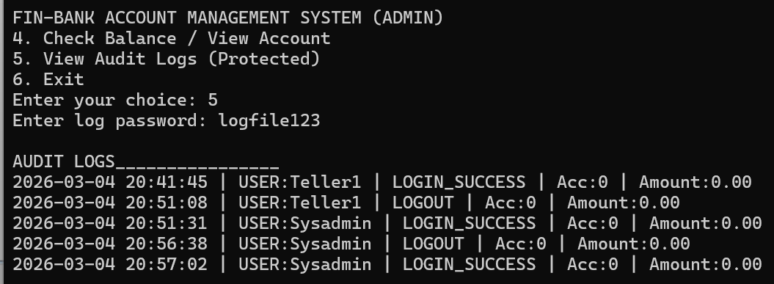
User Authentication, Authorization & Logging
Login as Teller
Login as System Admin
Audit Trail
- For Accountability

Slide 4
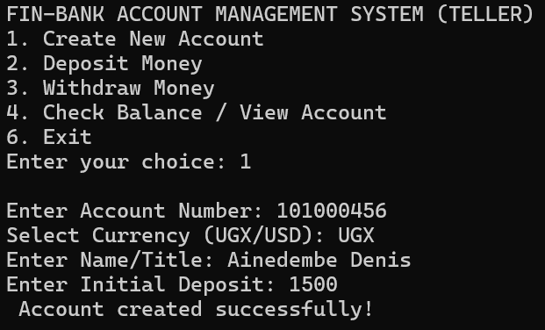
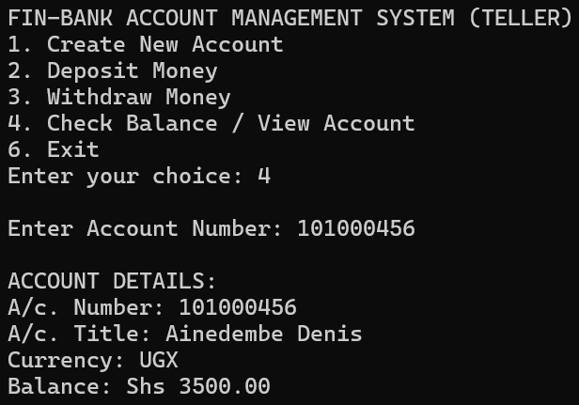
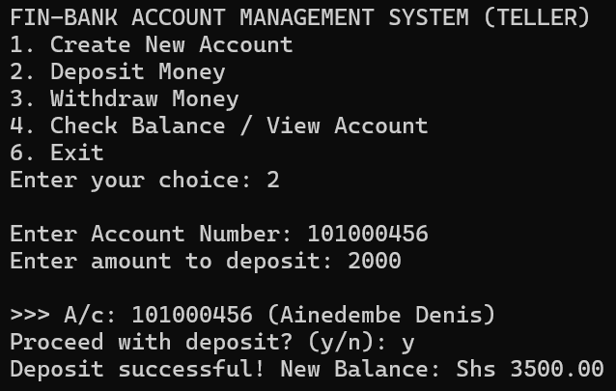
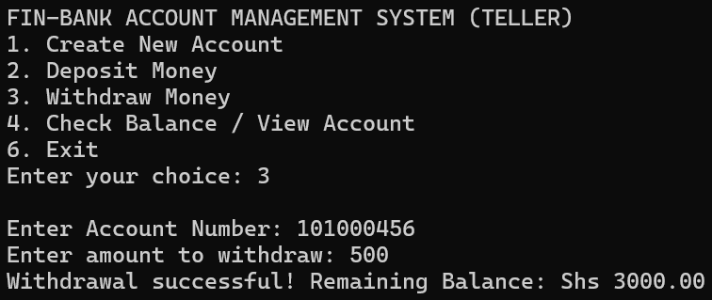
Actions
Create New Account
Account Inquiry
Deposit money to account
Withdrawing money

Slide 5
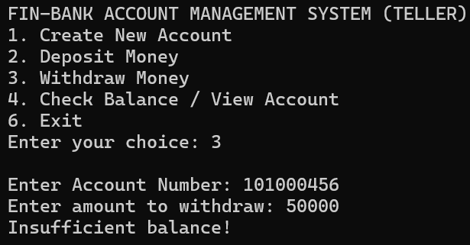
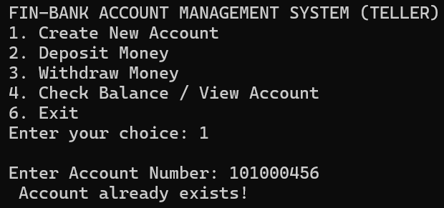
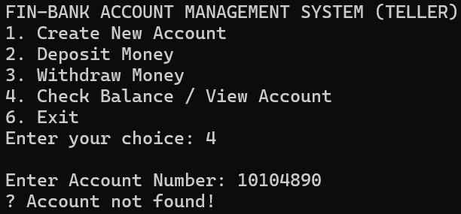
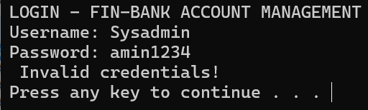
Checks / Controls
Insufficient balance check
Duplicate Accounts check
Account not found check
Invalid credentials check

Slide 6
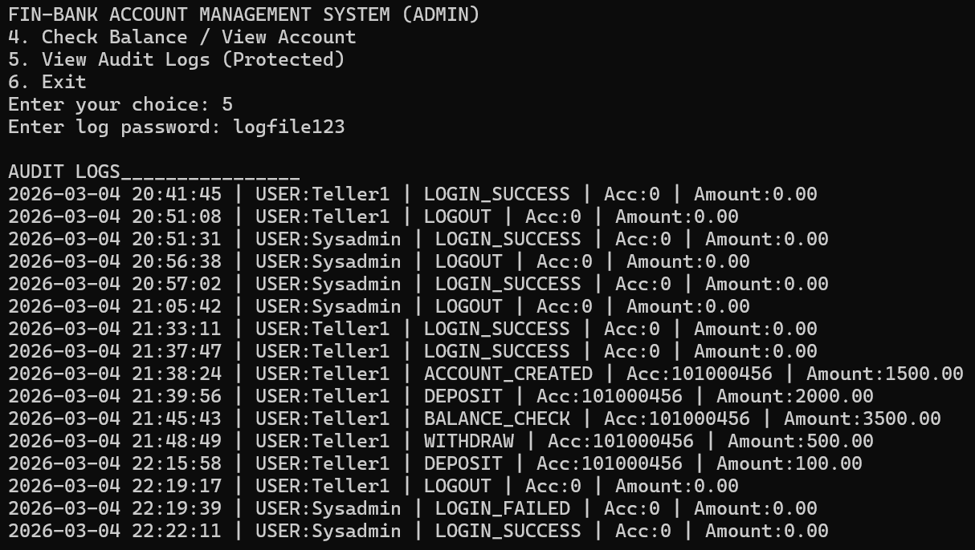
Audit Trail

Slide 7

Loan Eligibility & EMI Calculator
2
This program calculates the Monthly Loan EMI (Equated Monthly Installment).
The program converts the annual interest rate to a monthly interest rate.
It then uses the EMI formula to compute the monthly payment and then checks loan eligibility.
A person is eligible for the loan only if the EMI is less than or equal to 40% of their monthly salary.

Slide 8
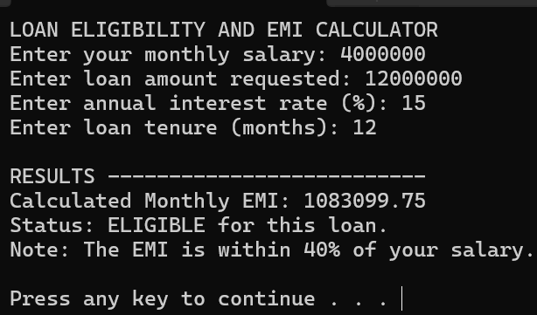
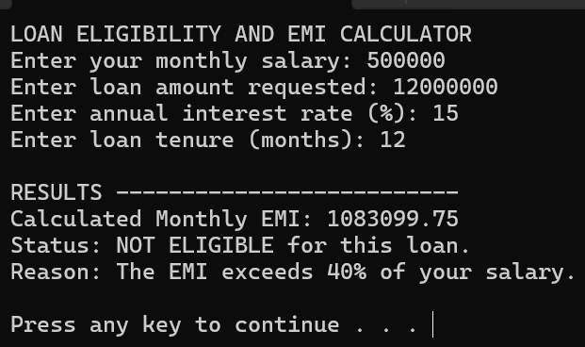

Checks / Controls
Not ELIGIBLE
The EMI is within 40% of salary
Not ELIGIBLE
The EMI exceeds 40% of salary
Where: P = Principal / Loan Amount R = Monthly Interest Rate N = Loan Tenure/duration in Months

Slide 9
Library Management System
3
Add Book – Stores new books with ID, title, and author in a file.
Search Book – Finds a book by ID and displays its details and availability status.
Issue Book – Records when a student borrows a book, including borrower registration number, issue date/time, and expected return date.
Return Book – Updates the system when a borrowed book is returned.
Display Books – Shows all books stored in the library system.

Slide 10
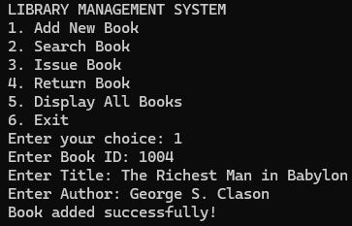
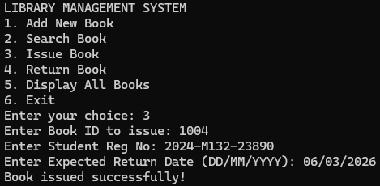
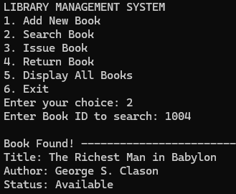
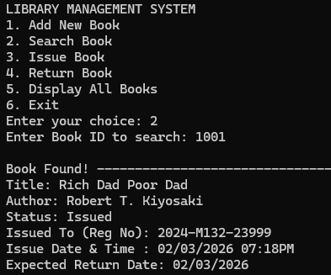
Actions
Create / Add a New Book
Issue out a Book
Search for a Book
Search for a Book
- Issued

Slide 11
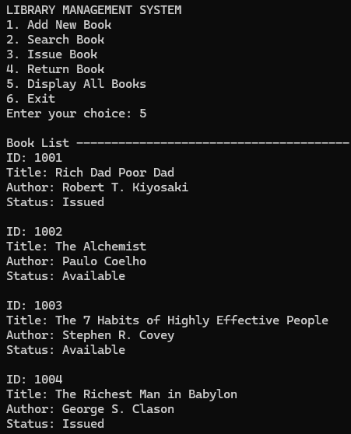
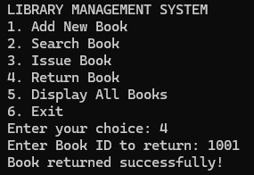
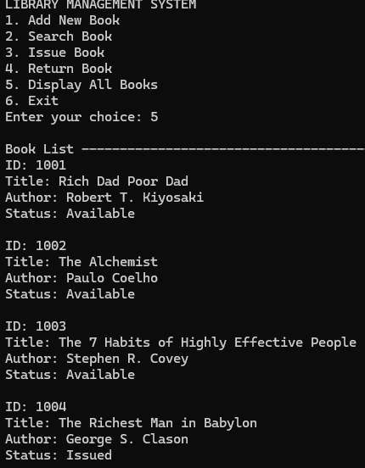
Actions
Display all Books
Return a Book
Available Books
- New status

Slide 12
Student Record Management System
4
Add Student – Records student details such as ID, name, gender, and marks for subjects.
Calculate Results – Automatically calculates the average score and assigns a grade (A–F) based on performance.
Display Reports – Allows viewing all students sorted by average score or displaying an individual student's report using their ID.
Search Student – Finds a specific student using their Student ID.
Save & Load Data – Stores records in a file so data is preserved even after the program closes.

Slide 13
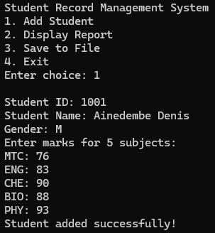
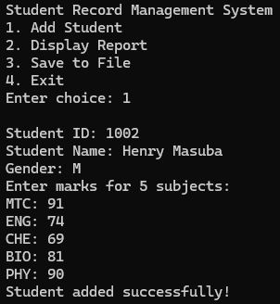

Actions - Add Student / Record Marks
Add student marks - 1
Add student marks - 2
Add student marks - 3

Slide 14
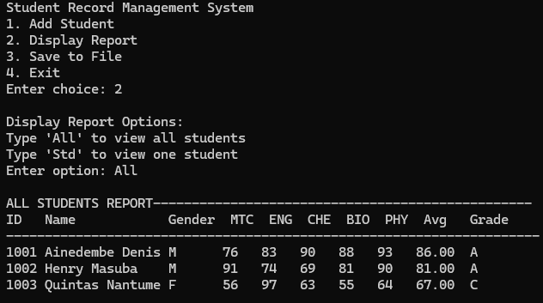
Actions
Display all Student Marks

Slide 15
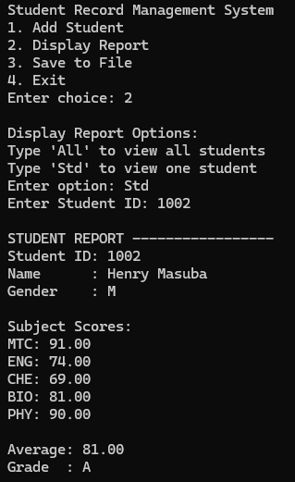
Actions - Display Marks for a Student
Display the
Student’s marks

Slide 16
Hospital Patient Management System
5
Doctor Management – Add and store doctor details including ID, name, and specialization.
Patient Management – Register patients with ID, name, and age.
Appointment Scheduling – Create and manage appointments between doctors and patients.
Diagnosis Recording – Doctors can record diagnoses for completed appointments.
Billing System – Add and update bill items such as treatment or medical services.
Patient History Tracking – View a patient's complete medical history including diagnoses and total bills.

Slide 17
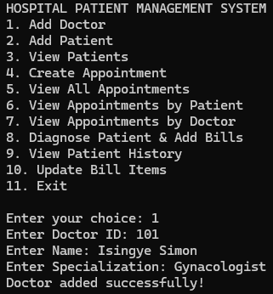
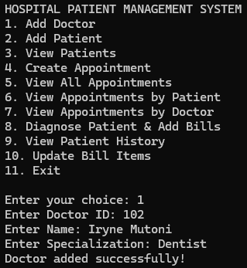
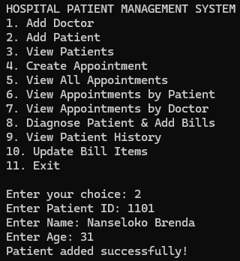
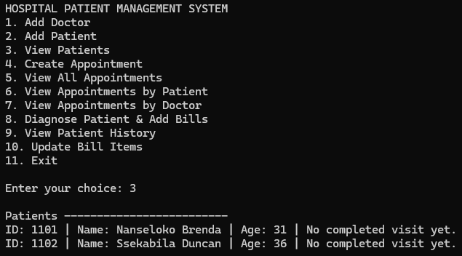
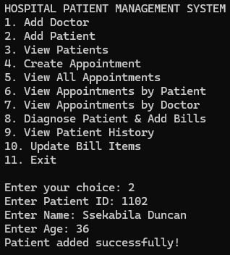
Actions – Create Doctor, Create Patient
Create Doctor (1)
Create Doctor (2)
Create Patient (1)
Create
Patient (2)

Slide 18
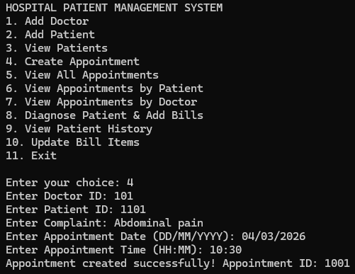
Actions – Create Appointment
Create Appointment
Doctor Selection (valid Doctor ID)
Patient Identification (A Patient ID is entered and verified)
Appointment Details Entry
Patient complaint/symptoms
Appointment date & time
Appointment Creation
The system automatically generates a unique Appointment ID and saves the appointment with status = Pending.
View all Appointments

Slide 19
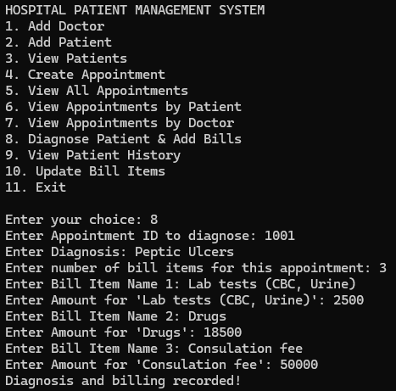
Actions – Diagnosis & Billing
Diagnosis & Billing
Select Appointment
The user enters the Appointment ID to access the patient's consultation record.
Record Diagnosis
The doctor enters the medical diagnosis based on the patient's complaint and examination
Add Medical Bill Items
The system records all services provided during treatment
Enter Cost for Each Item. Each bill item has an associated amount, which is stored in the billing file.

Slide 20
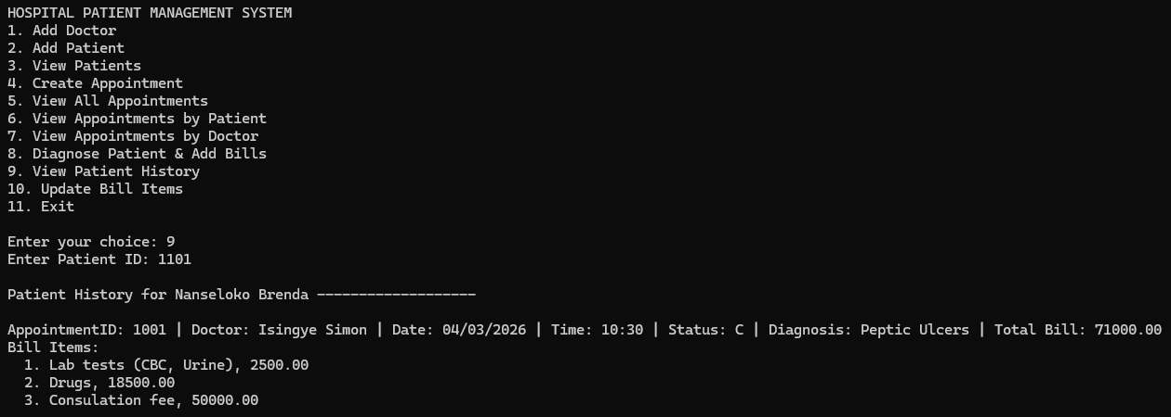
Actions – View Patient History
Patient History

Slide 21
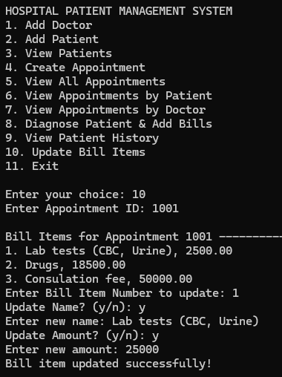
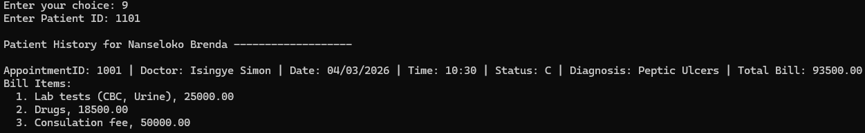
Actions – Update Bill items
Update Bill items
Patient History – Bill item updated

Slide 22
Pharmacy Inventory System
6
Medicine Management
Add new medicines with ID, name, quantity, price, and expiry date; Store records in a file
Stock Control
Refill medicine stock when inventory is low
Automatically highlights low stock items (≤5 units)
Sales & POS System
Allows selling multiple medicines in one transaction
Calculates subtotal and grand total & Updates inventory after purchase
Generates printed receipt with date and purchased items
Expiry Monitoring
Checks medicines against today's date
Displays expired medicines to prevent unsafe sales
Sales Tracking
Stores every transaction
Calculates total pharmacy revenue

Slide 23
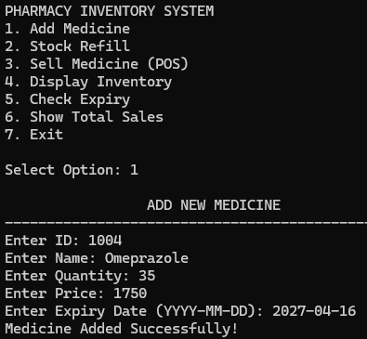
Actions - Add Medicine
Add Medicine

Slide 24
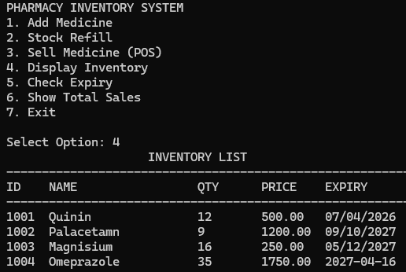
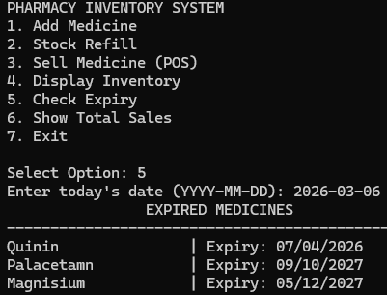
Actions - Display Inventory, Check Expiry
Display Inventory
Check Expiry

Slide 25
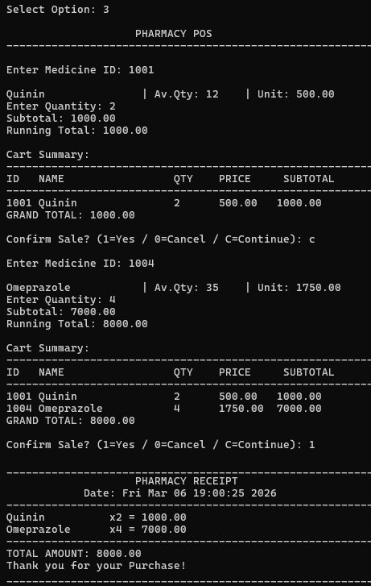
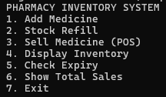
Actions - Sell Medicine
Sell Medicine

Slide 26
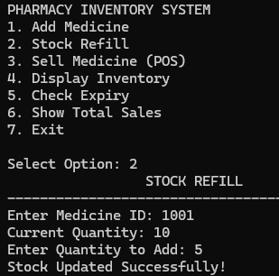
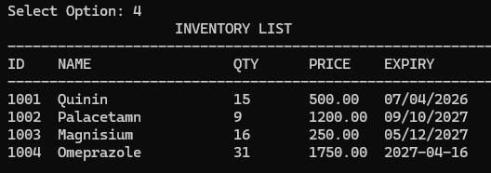

Actions – Stock Refill, Show Total Sales
Stock Refill
Check Inventory
Show Total Sales

Slide 27
Bus Reservation System
7
View Seat Layout – Displays a 10 × 4 bus seating arrangement showing available and booked seats.
Book Seat – Passenger selects row and seat number and enters their name. The booking is saved to a file.
Cancel Booking – Allows cancellation of a booked seat and updates the booking file.
Display Passenger List – Shows all passengers with their seat numbers.
Persistent Storage – Uses a binary file to store bookings permanently.

Slide 28
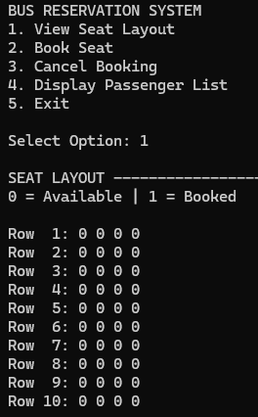
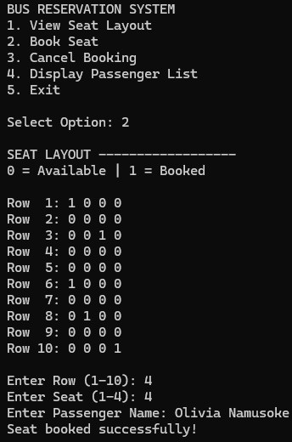
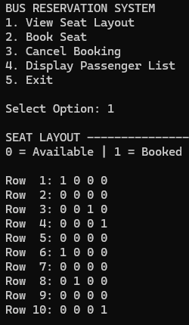
Actions – Book a Seat, Seat Layout
View Seat Layout
Book a Seat
New - Seat Layout

Slide 29
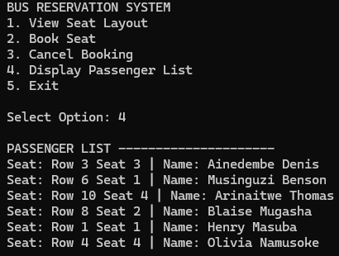
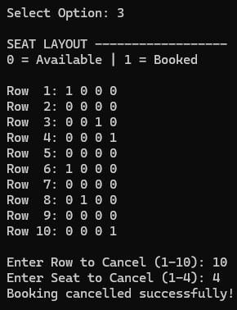
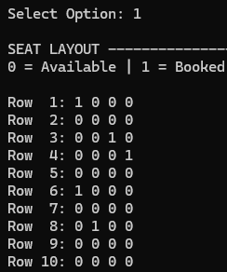
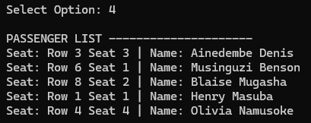
Actions –Passenger List, Cancel Booking
Passenger List
Cancel Booking (10, 4)
New - Seat Layout
New - Passenger List

Slide 30
Vehicle Fleet Management System
8
Add Vehicle – Records vehicle ID, type, mileage, and fuel usage.
Record Maintenance – Updates vehicle mileage after maintenance.
Track Fuel Usage – Records fuel consumption for each vehicle.
Maintenance Alert – Identifies vehicles that exceed a mileage threshold and need servicing.
Display Fleet – Shows all vehicles with their mileage and fuel usage.

Slide 31
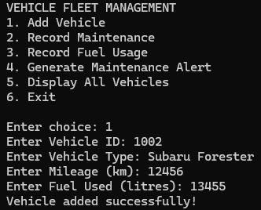


Actions
Add Vehicle
Record Maintenance
Display All Vehicles

Slide 32


Actions
Generate Maintenance Alert
Record Fuel Usage

Slide 33
END
STUDENT
Ainedembe Denis
LECTURER
Dr. Wauyo Fred
https://github.com/Ainedembe-Denis/Systems-Programing---C-PROJECTS

